Slide 1

Project 1
Real Estate
Understanding the Influences upon Property Prices in Melbourne
Presented by:
Kali Notaras
Keerthi Chippa
Basudeb GhosH
Aayush Gupta
Christopher Banh

Slide 2


Project Description & Outline
Melbourne Property Price Insights
For Buyers:
For Sellers:
Key attributes influencing Property Prices
Insights per Living Demographic
Refined pricing estimates
Evaluate the performance of Melbourne’s top real estate agencies.

Slide 3
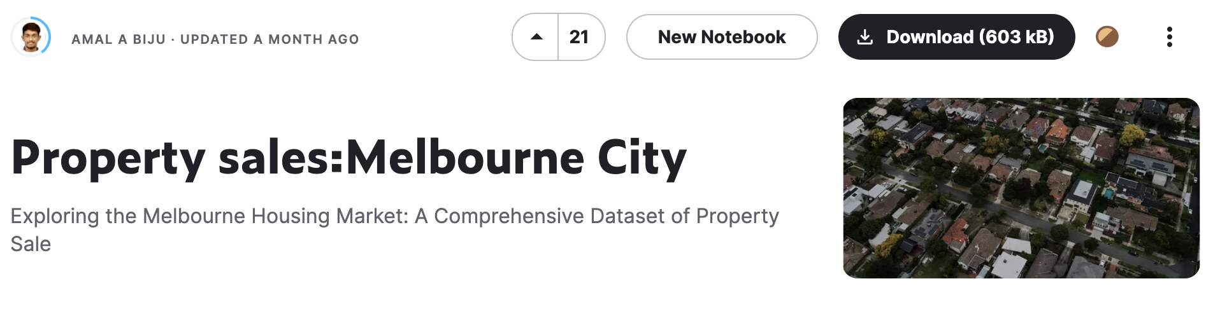
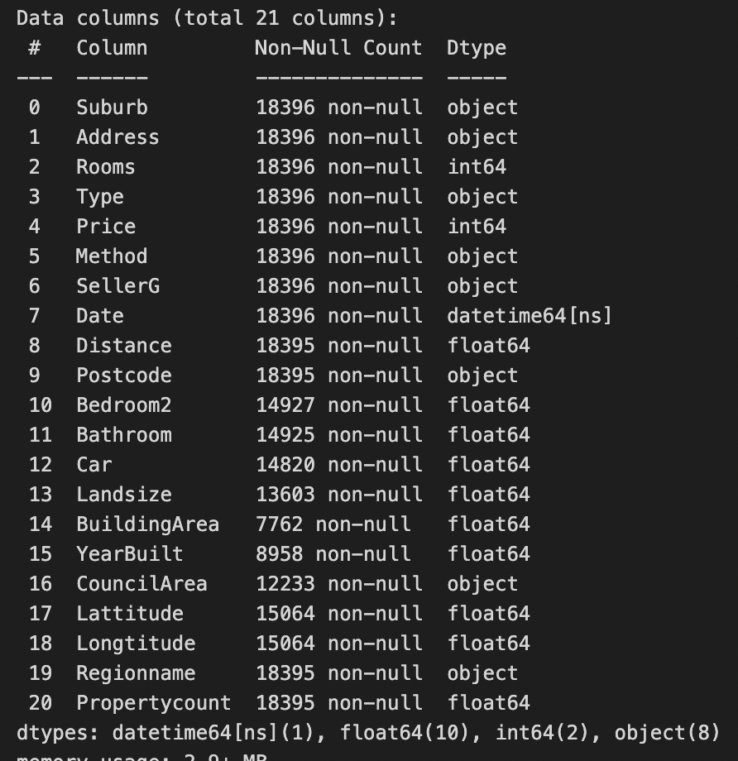
Dataset & Initial Data Cleaning
Source: Data generated by Biju, A.A. (2023). Property sales:Melbourne City.
Accessed on 4 April 2023. URL: https://www.kaggle.com/datasets/amalab182/property-salesmelbourne-city
Cleaned Dataset
21 Columns
18,396 Rows

Slide 4
QUESTION 1.
What are the main influences on Property Prices in Melbourne?

Slide 5
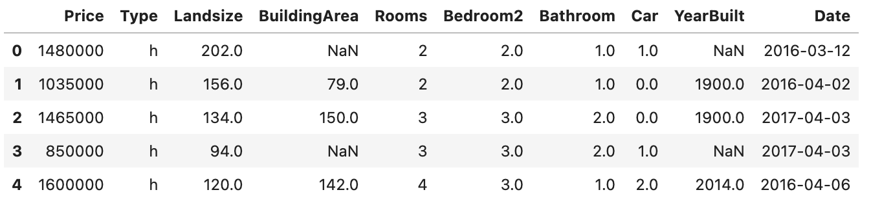
QUESTION 1.
Data Exploration & Cleaning
Dependent Variable
Price
Number of Bedrooms
Number of Bathrooms
Parking Spots
Year Built
Date of Sale
Independent Variables
Property Type
Land Size
Building Size
Rooms

Slide 6
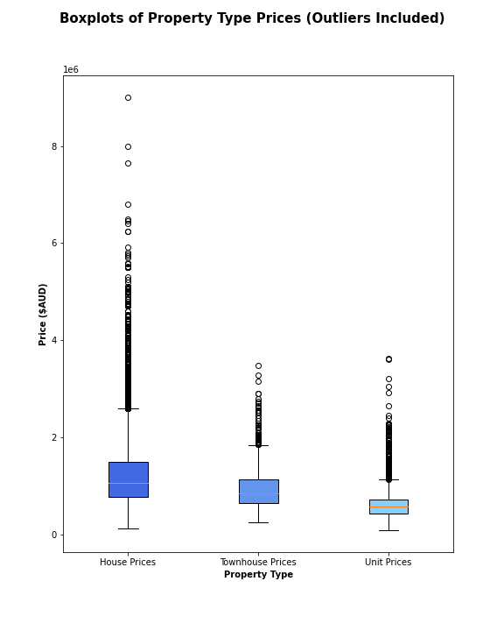
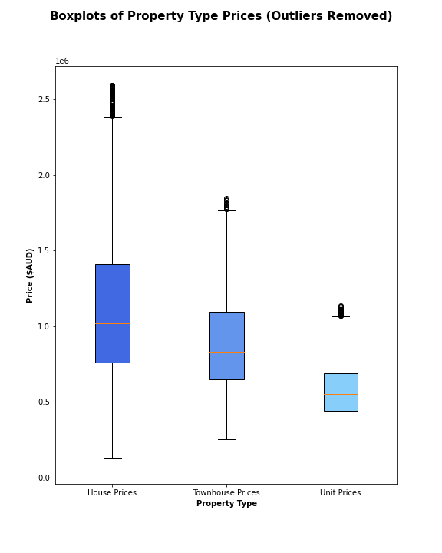
QUESTION 1.
Data Analysis: Property Type

Slide 7
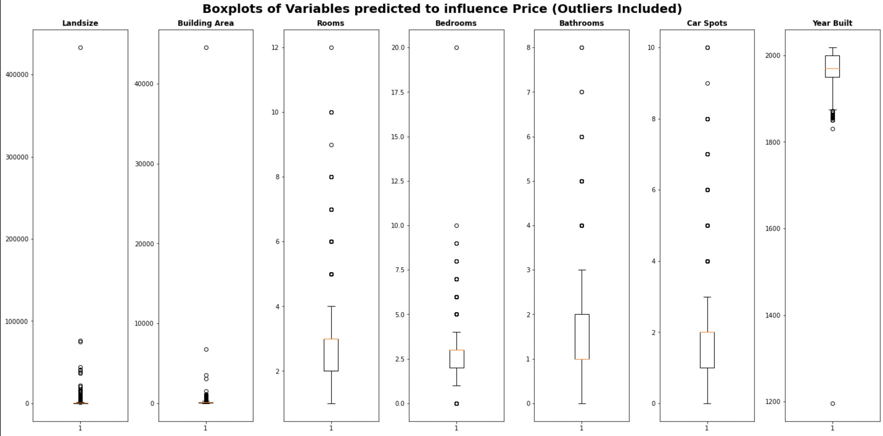
QUESTION 1.
Data Analysis: Dependent Nominal Variables

Slide 8
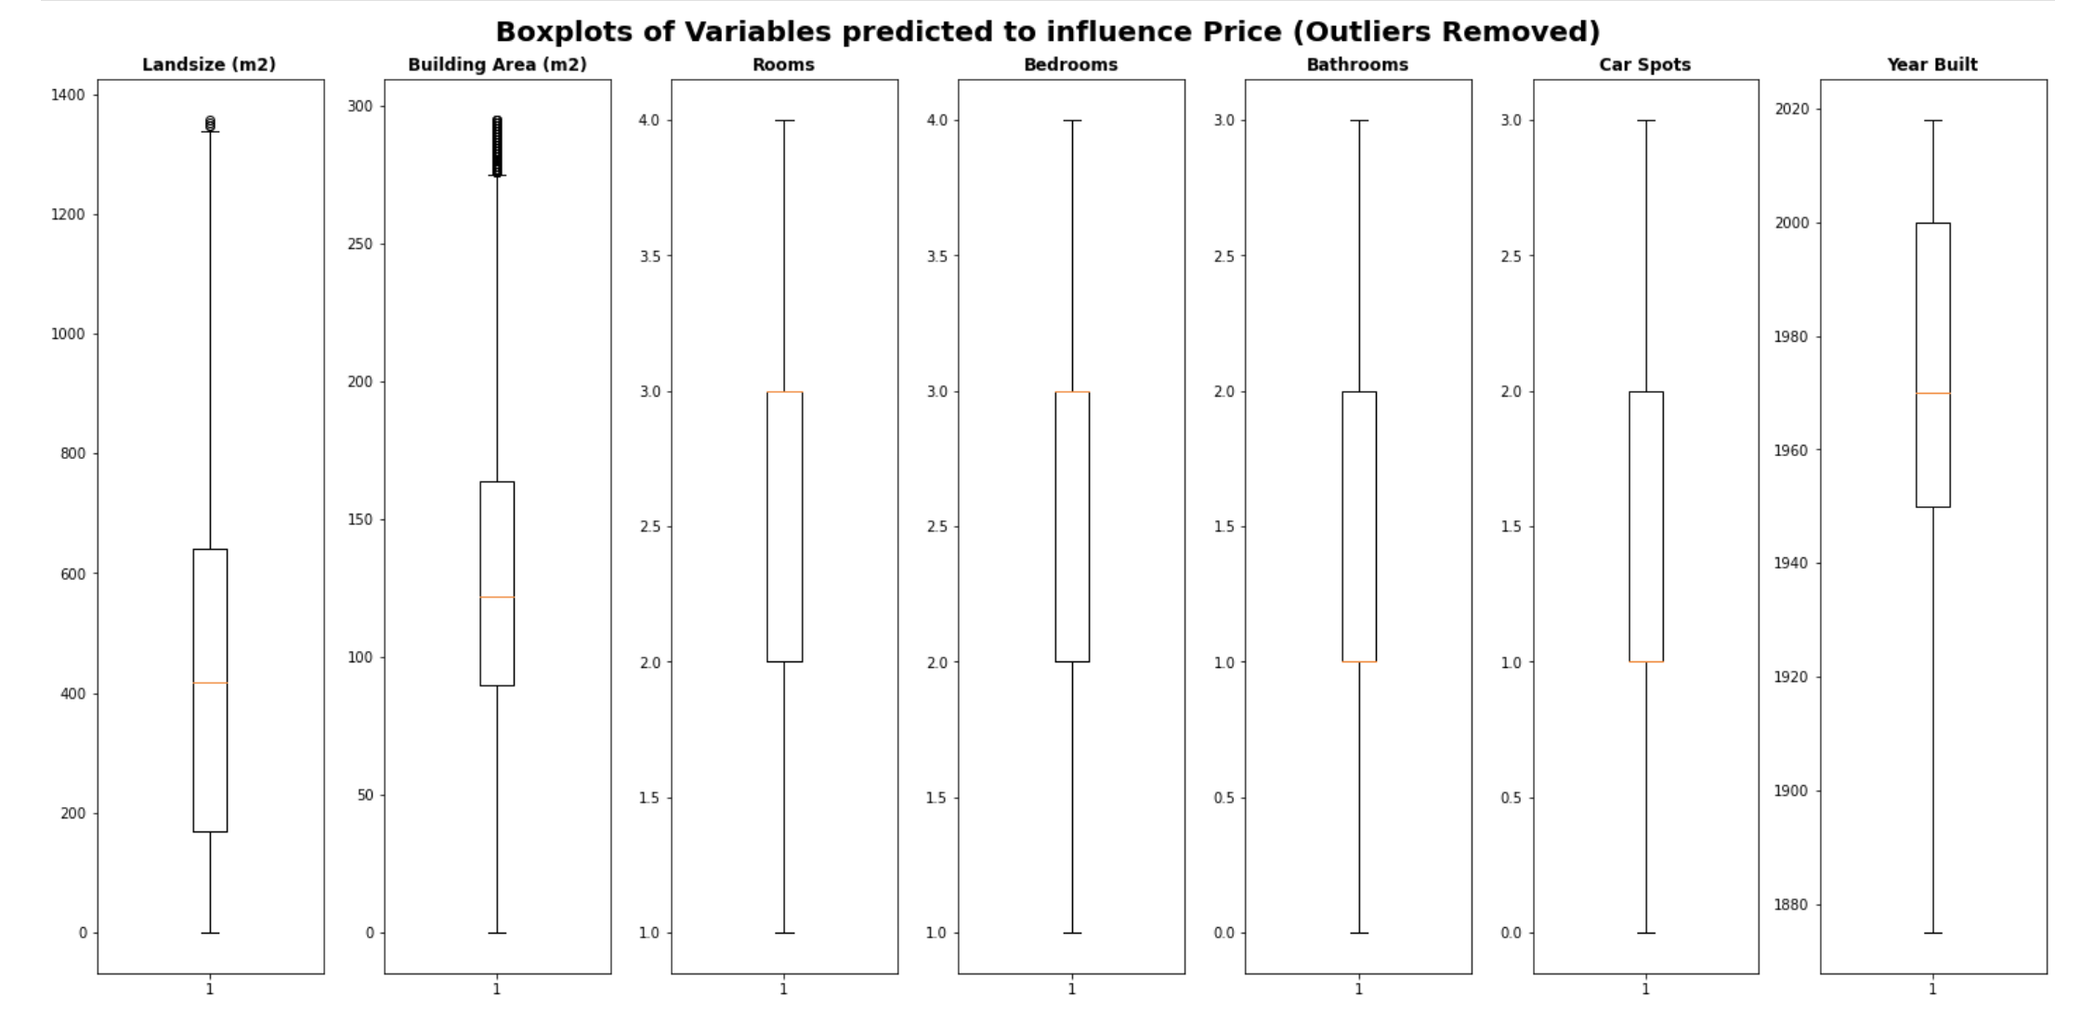
QUESTION 1.
Data Analysis: Dependent Nominal Variables

Slide 9
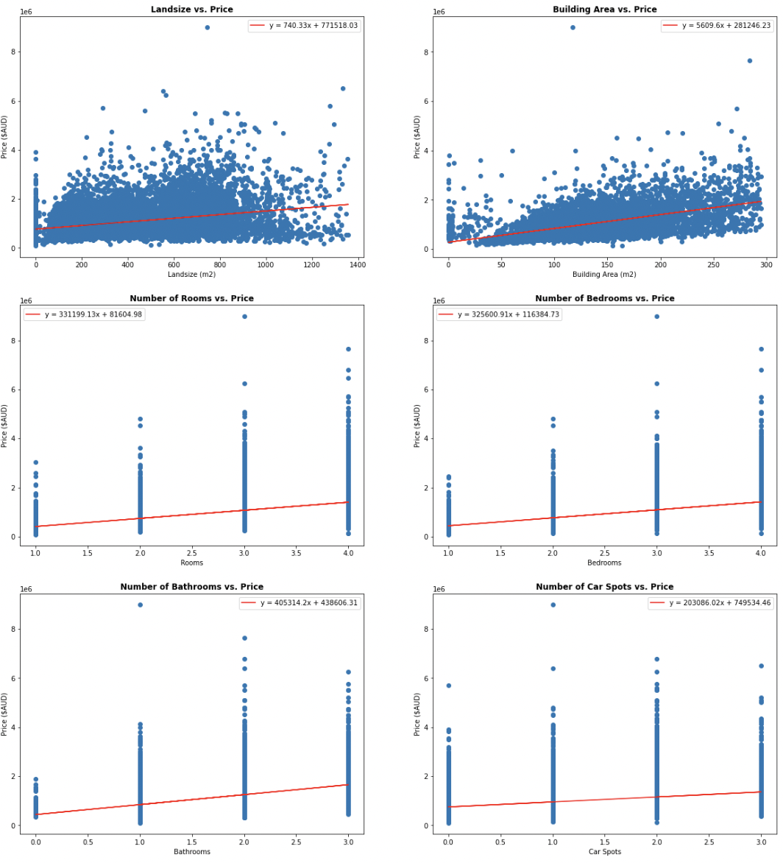
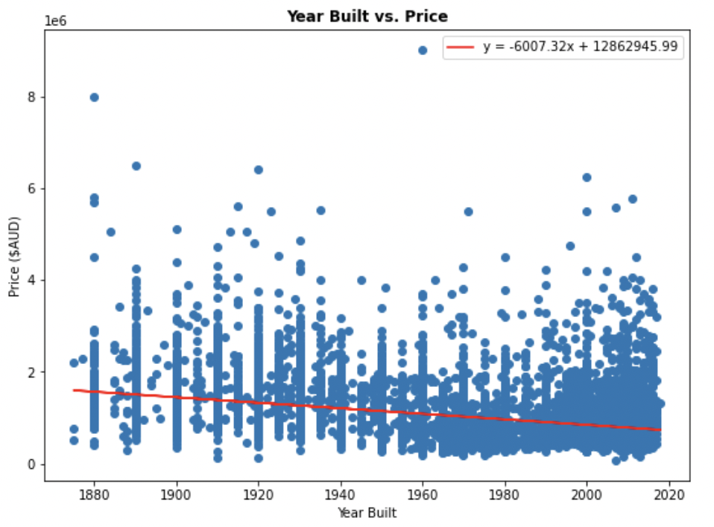
QUESTION 1.
Data Analysis: Dependent Nominal Variables
Continuous Variables
Ordinal Variables

Slide 10
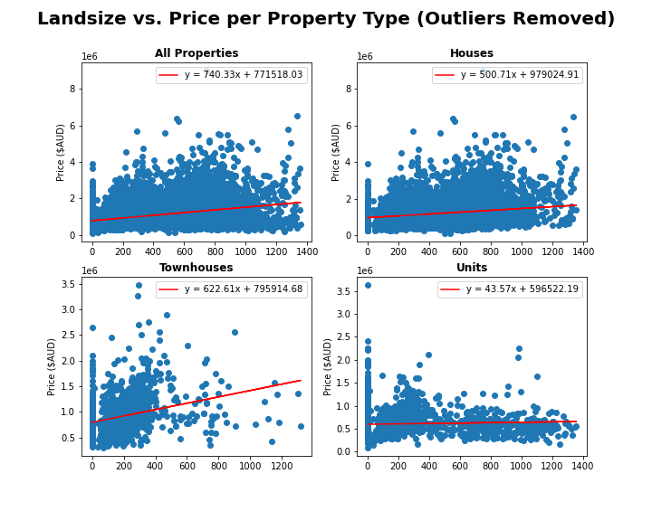
QUESTION 1.
Data Analysis: Dependent Nominal Variables
Correlation Values
All
House
Townhouse
Unit
0.339
0181
0.280
0.048

Slide 11
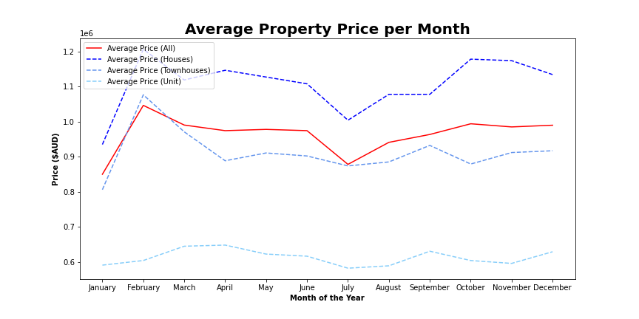
QUESTION 1.
Data Analysis: Date of Sale

Slide 12
Q2: Looking to buy in Melbourne? What location is best for you and your bank account
Parameters Used:
Distance from CBD
Location
Target Demographic
Property Type – Unit (u), Townhouse (t), House (h)

Slide 13
Q2: Looking to buy in Melbourne? What location is best for you and your bank account

Slide 14
Q3: Looking to sell in Melbourne? Which real estate agency will get you the best value?
Parameters Used:
Number of properties sold
Performance of price above average (Z-score average)
Location-based performance
Method of Sale

Slide 15
Q3: Looking to sell in Melbourne? Which real estate agency will get you the best value?

Slide 16
Final summary of implications
Add some conclusion points

